Slide 1
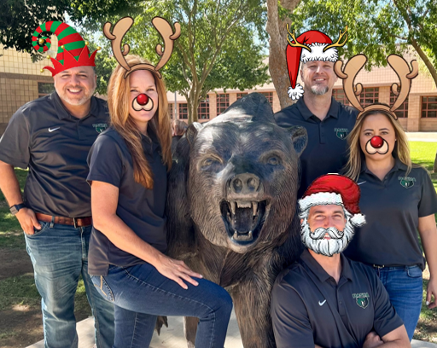
Welcome to Basha High
2023 - 2024

Slide 2
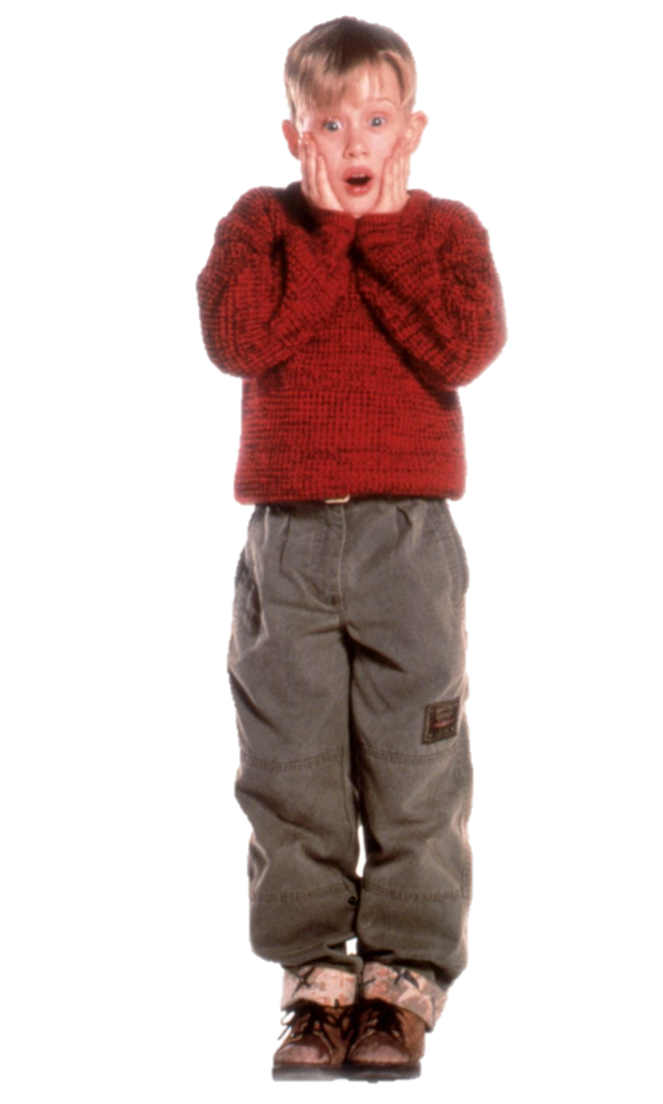
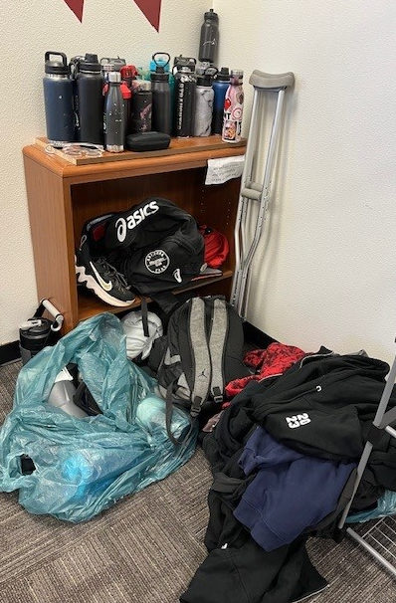
I’m LOST! Please find me!
On December 22nd, ALL unclaimed items will be donated.
If you have a lost item, please go to the LOST AND FOUND located in the Attendance Office and claim yours today!! Thanks.
Your stuff misses you too!

Slide 3
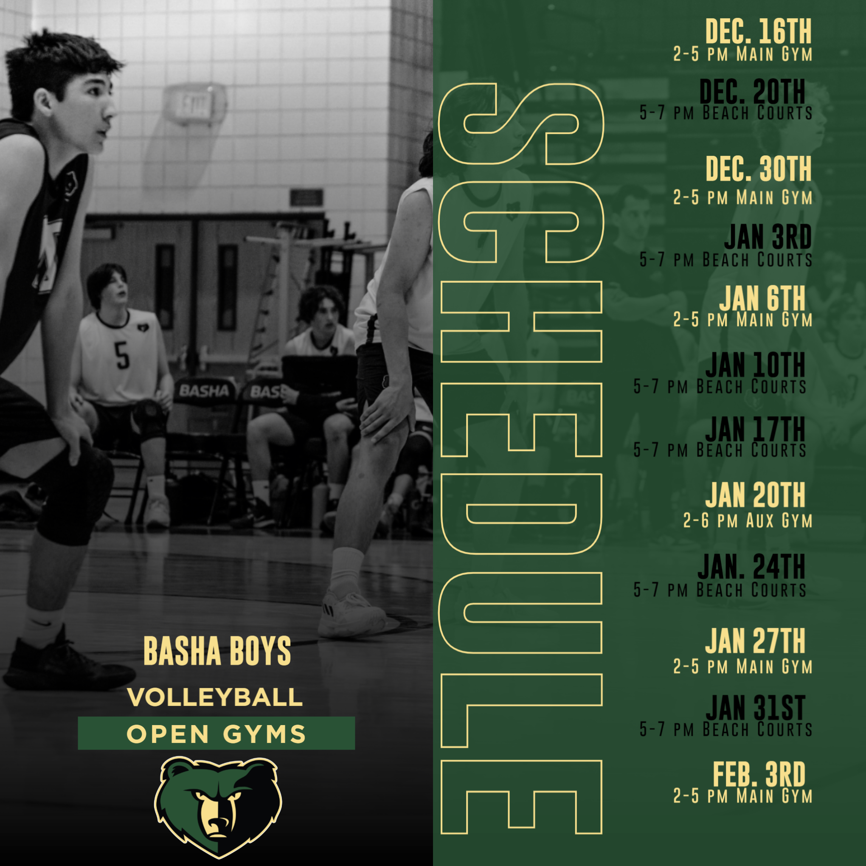
Attention Basha Boys!
The Boys Volleyball program is gearing up for another amazing season. We will be starting our Open Gyms for this upcoming season next Saturday, Dec. 16th from 2-5 pm in the main gym. Please come dressed out and bring plenty of water. If your intentions are to try-out for this upcoming season, we highly recommend attending as many open gyms as possible. This will give our coaches a good amount of time to really see your skills. We are looking forward to meeting you and seeing you out on the courts. If you have any questions, please contact Coach Aviles at Aviles.christopher@cusd80.com.

Slide 4
TONIGHT!!

Slide 5
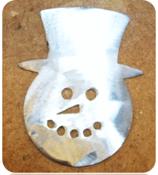
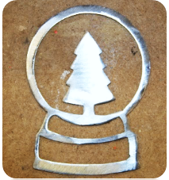
METAL ORNAMENTS FOR SALE $6
Order yours today with Mr. Hartfield (H118)
Color options available!
Cash, Check, or
Card accepted
Orders will be ready by the end of the semester.

Slide 6
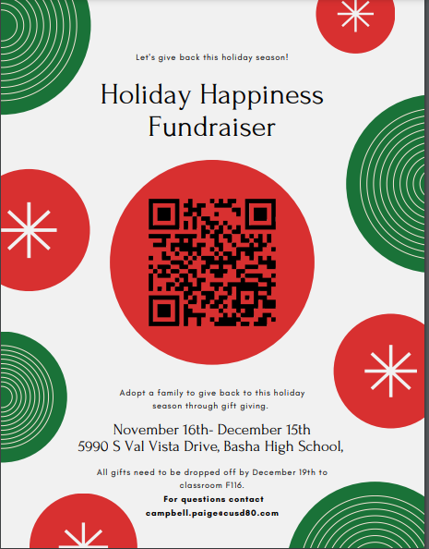

Slide 8
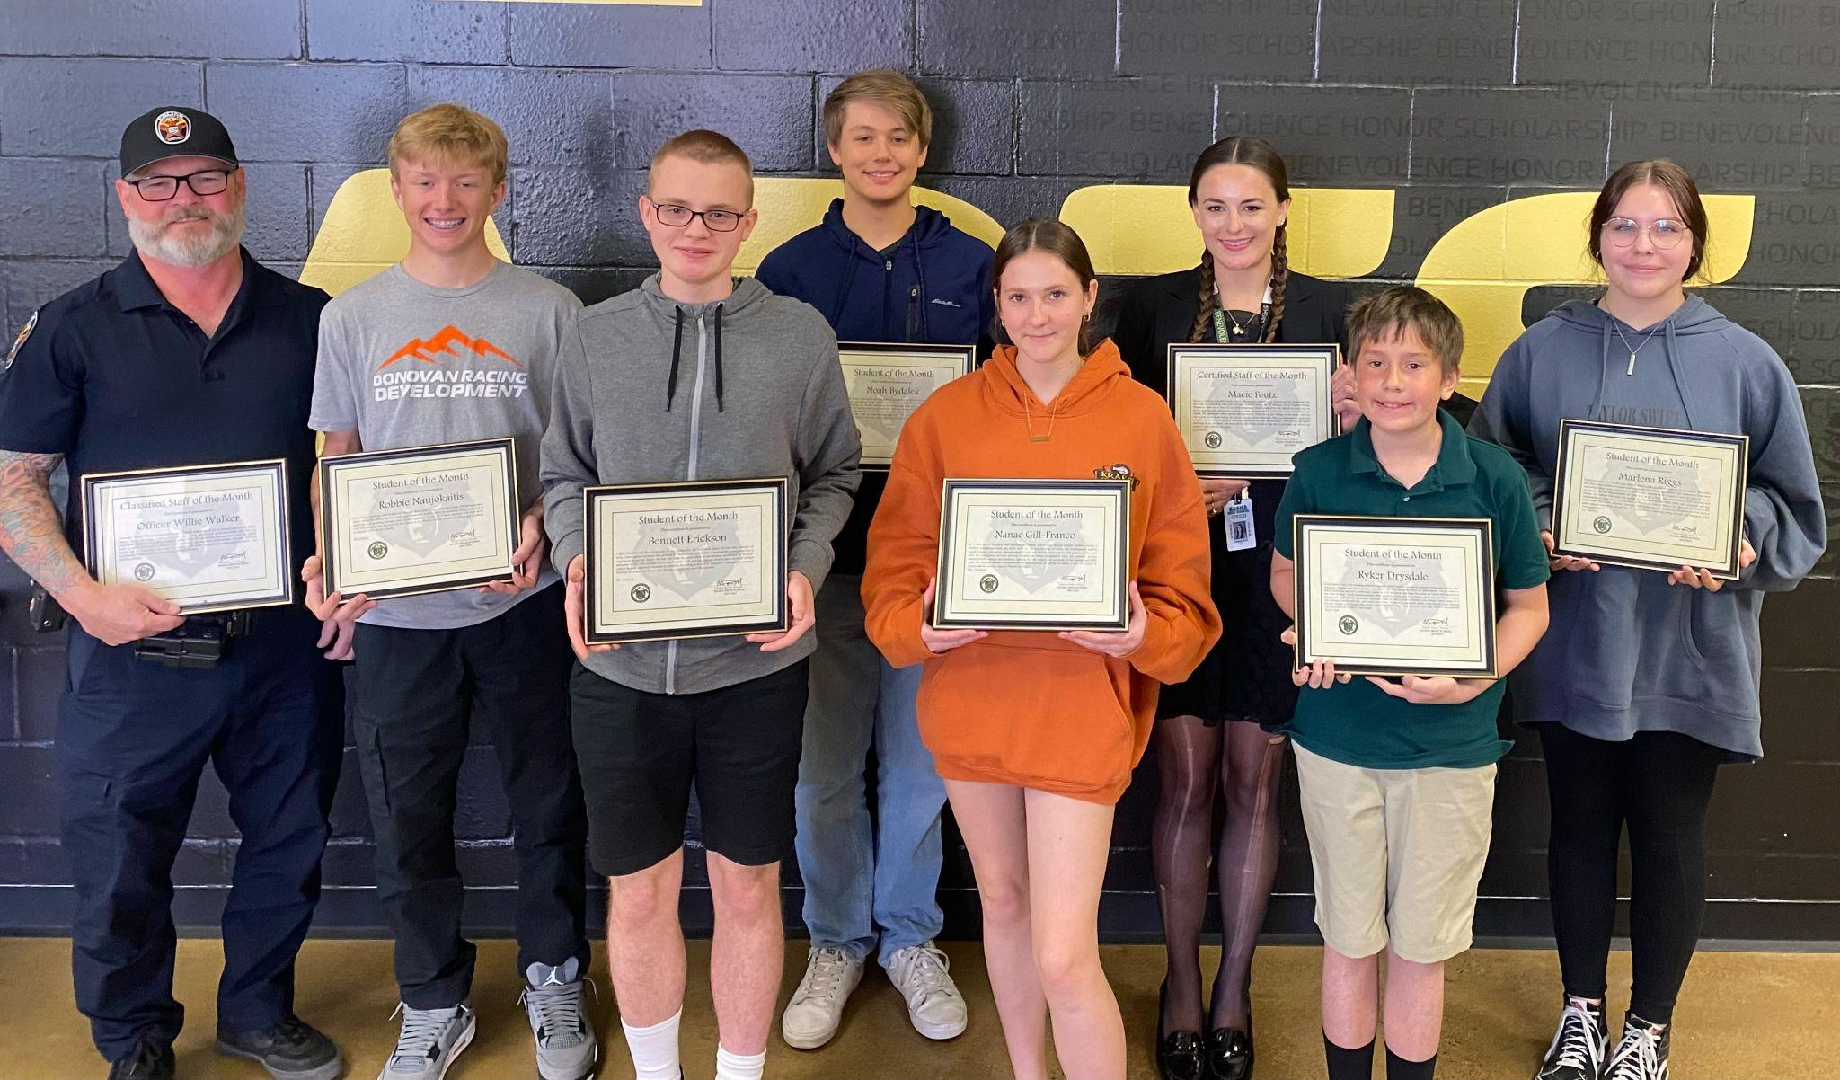
Congratulations to our Student/Staff of the Month winners!
Officer Willie Walker, Robbie Naujokaitis, Bennett Erickson, Noah Bydalek, Nanea Gill-Franco, Macie Foutz, Ryker Drysdale, and Marlena Riggs

Slide 9
SENIORS
Don’t delay purchasing your CAP & GOWN for graduation!
Go to Jostens.com and purchase yours today!

Slide 11
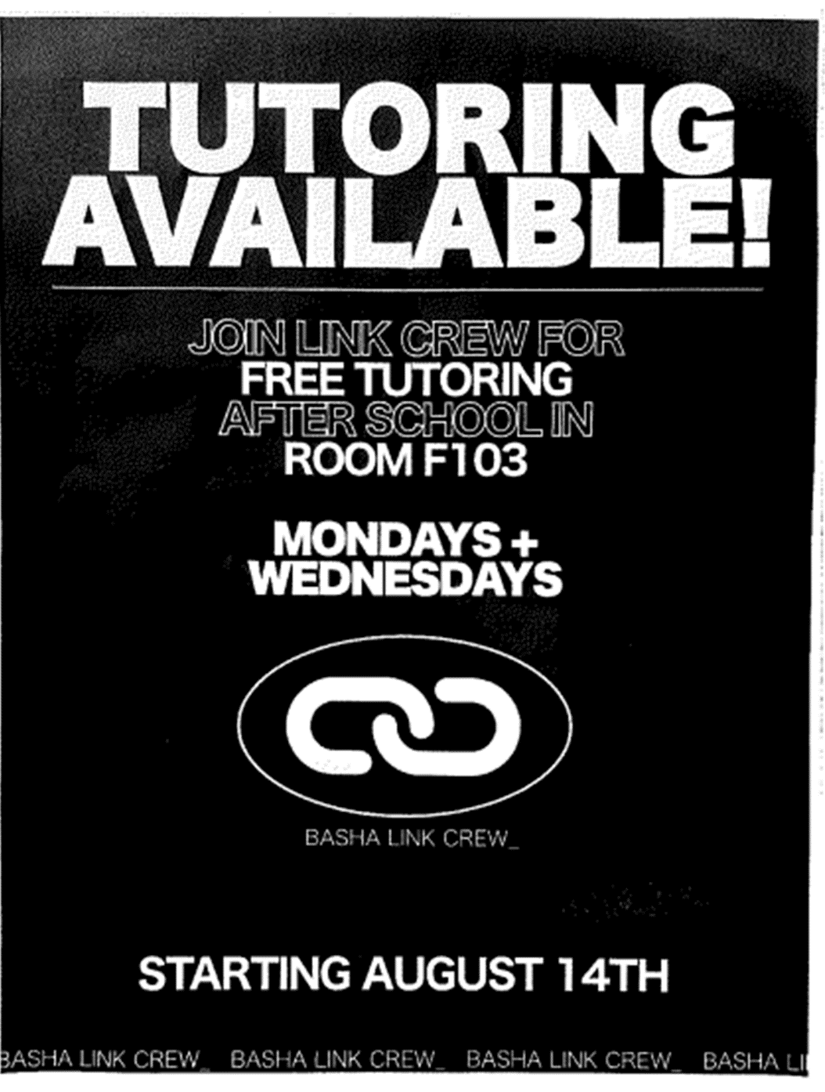

Slide 12
MUFFINS FOR SALE
$2
After 1st and 2nd hour in the breezeway

Slide 13
Students!
You must have your parking tag hanging on your rearview mirror. Cars without a parking tag will be ticketed.
Students, please do not park in the Admin. Parking lot.
Thank you.

Slide 16
BASHA HIGH
does not accept food deliveries or food drop offs.
Thank you!

Slide 17
Mindfulness Room
Relax with guided meditation in the
Mindfulness Room
on
Fridays
7:05AM-7:20AM

Slide 18
Free or Reduced Meals
Do you know if you’re eligible for free or reduced-priced school meals? Were you eligible last year? Applications must be submitted each school year. Visit myschoolapps.com to complete an application.

Slide 19
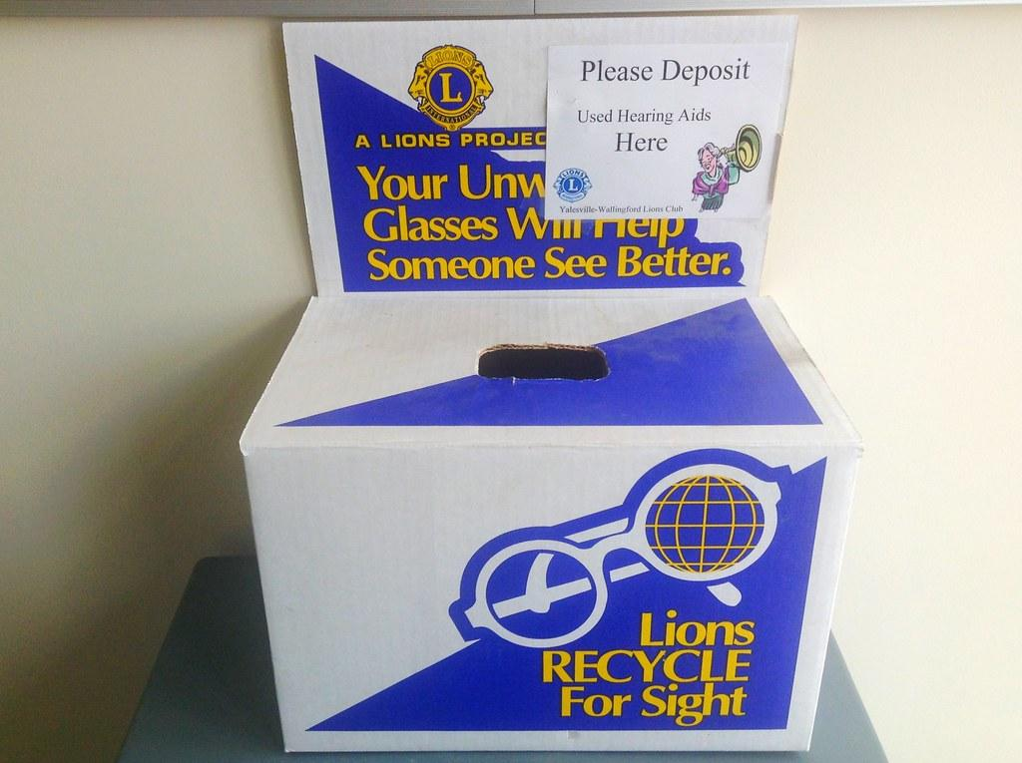
Your unwanted glasses will help someone see better!
DONATE today! The box is located in the Admin building @Kalli’s desk.

